Slide 1


MIST
CAMPUS
Group-4
202114014- Aunindya Prosad Saha
202114025 - Fahim Tazwar Deesun
202114052 - Md Raiyan Bhuyian Loreen
202214052 - Raisul Islam Rahad
MIST Campus

Slide 2



Problem
Many universities in Bangladesh lack smart infrastructure, leading to inefficient resource management, security risks, and limited automation.
Problem 1
Problem 2
Problem 3
Need to protect sensitive student, faculty, and institutional data.
Efficient resource allocation is crucial for academic and administrative tasks.
Institutions need expandable networks for increasing users.

Slide 3

MIST
Campus
A networking and automation project showcasing existing smart solutions at MIST while introducing new features like RFID access, web services, and security automation.

Slide 4
Objectives
Secure & Scalable Network Infrastructure (21 VLANs for departments, 2 VLANs for hostels)
Inter-Department Connectivity using VLANs, RIPv2 routing, and static routes
Smart Campus Services – Web, Email, and DNS Servers for seamless communication
IoT-Based Features – RFID access control, fire monitoring, automated announcements
Dynamic IP Allocation – Configured DHCP servers to automate IP assignments

Slide 5
System Design
VLAN Segmentation:
- 21 VLANs for departments, 2 VLANs for hostels to ensure secure & efficient network isolation.
2. Routing Mechanism:
- RIPv2 for internal data routing, Static Routing for external access.
3. Security Measures:
- ACLs (Access Control Lists) to control unauthorized access between VLANs.
4. DHCP Implementation:
- Automatic IP allocation for devices in different VLANs.

Slide 6
System Design
IoT-Based Features
Fire Alarm & Sprinkler System: Automatic fire detection & sprinkler activation for emergencies.
Sound System (Piezo Speakers): Automated announcements & emergency alerts for campus-wide communication.
RFID-Based Access Control: Automated door unlocking upon RFID authentication, restricting unauthorized access.

Slide 7
Workflow
Network Infrastructure Setup
Core Networking Devices Used:
3x Cisco 2811 Routers – Handles Inter-VLAN Routing & External Communication.
2x Multi-Layer Switches (Cisco 3560) – Manages VLAN Routing & Layer 3 Switching.
23x Cisco 2950 Switches – Provides Layer 2 VLAN Segmentation.
3x Servers (Web, Email, DNS) – Ensures Centralized Digital Services & Domain Resolution.
Network Segmentation & VLANs
MIST Network – 21 VLANs for Departments, Labs, Research, and Administration.
Osmany Hall Network – 2 VLANs for Hostel Management & Student Connectivity.

Slide 8
Workflow
PCs from different VLANs connect through the network
Users can access the campus website using pre-configured domain names
Email services are fully functional for internal communication
IoT devices automate access, fire alerts, and speaker announcements

Slide 9
Key Features
Web Server – Hosts the campus website, accessible from any VLAN
Email Server – Functional email system for MIST’s internal network
DNS Server – Domain resolution for web and email services
RFID-Based Access – Automated door control with card authentication
Fire Monitoring System – Automated sprinkler and alert system
Piezo Speaker Announcements – Automated alerts for emergency situations

Slide 10
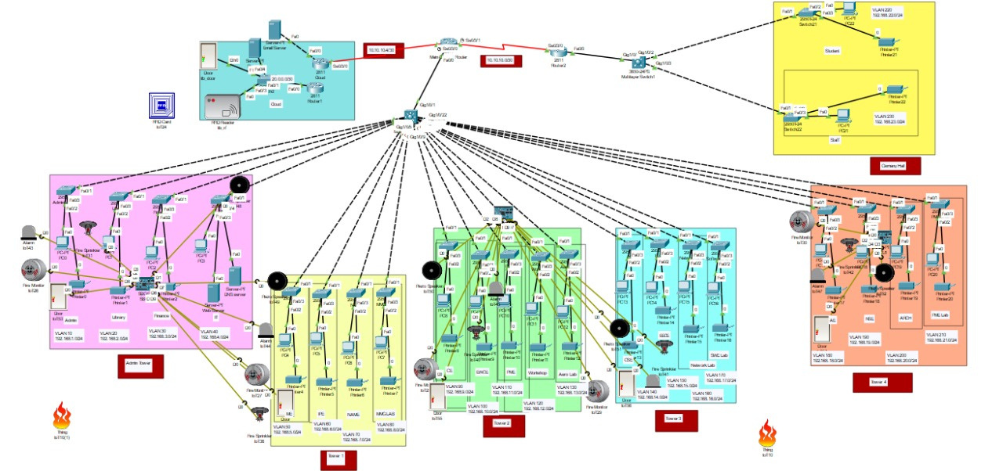
Project Snapshots

Slide 11
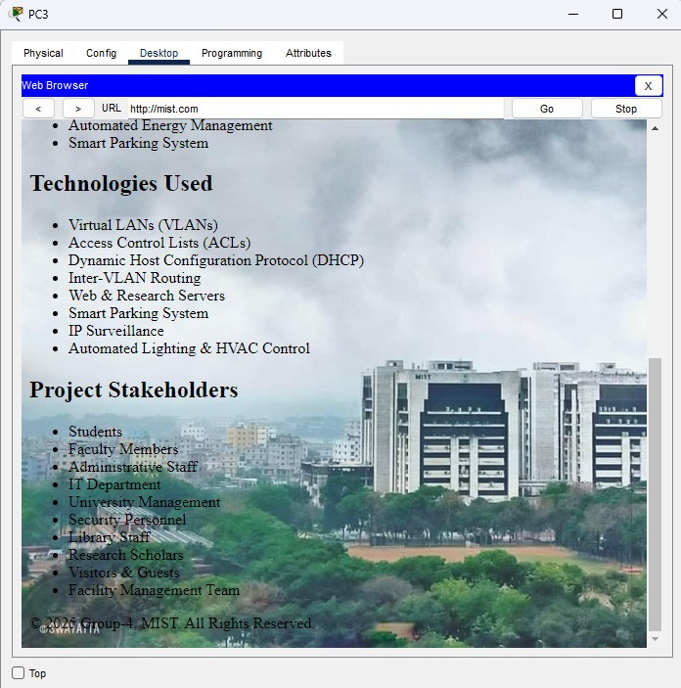
Key Features:
Hosted the campus demo website accessible via pre-configured domain names:

Slide 12
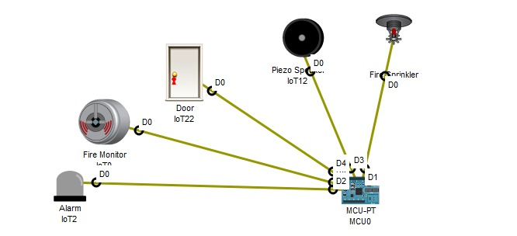
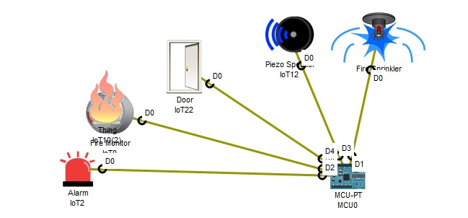
Key Features
IoT implementation (1)

Slide 13
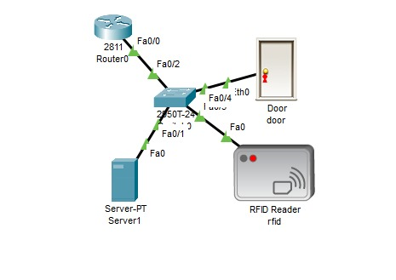
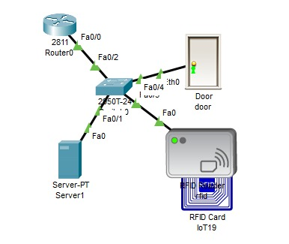
Key Features
IoT implementation (2)

Slide 14
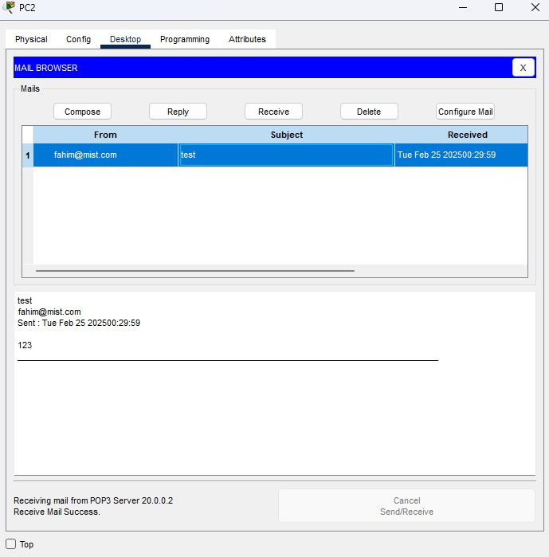
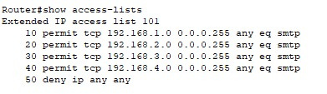
Key Features
Email inbox:
Email Server Access list:

Slide 15

DHCP Pool Configuration
IoT Device Constraints
Access Control List (ACL) Implementation
Challenges & Limitations

Slide 16
Expansion of cloud-based learning management systems (LMS).
Advanced AI-based network security monitoring.
Further IoT automation in campus utilities.
Setting up its web and app application.
Future Work

Slide 17
Any Questions?

